Slide 1
Plant Disease Detection: Comparison of CNNs and Transformers
Ayush Munjal
Guide: Prof. Rajbabu Velmurugan
DDP Phase-1
Department of Electrical Engineering IIT Bombay

Slide 2
Contents
Motivation
PlantVillage Dataset
Basic CNN model experiments
Transformers
Comparison of Transformers model with CNN model
TiH Onion Dataset

Slide 3
Motivation
Timely disease detection and classification helps in better treatment
Plants of interest: Onion & Tomato
CNN models were employed
Achieved good accuracy values
Didn’t had good interpretability
We try to improve interpretability of model using Transformer models

Slide 4
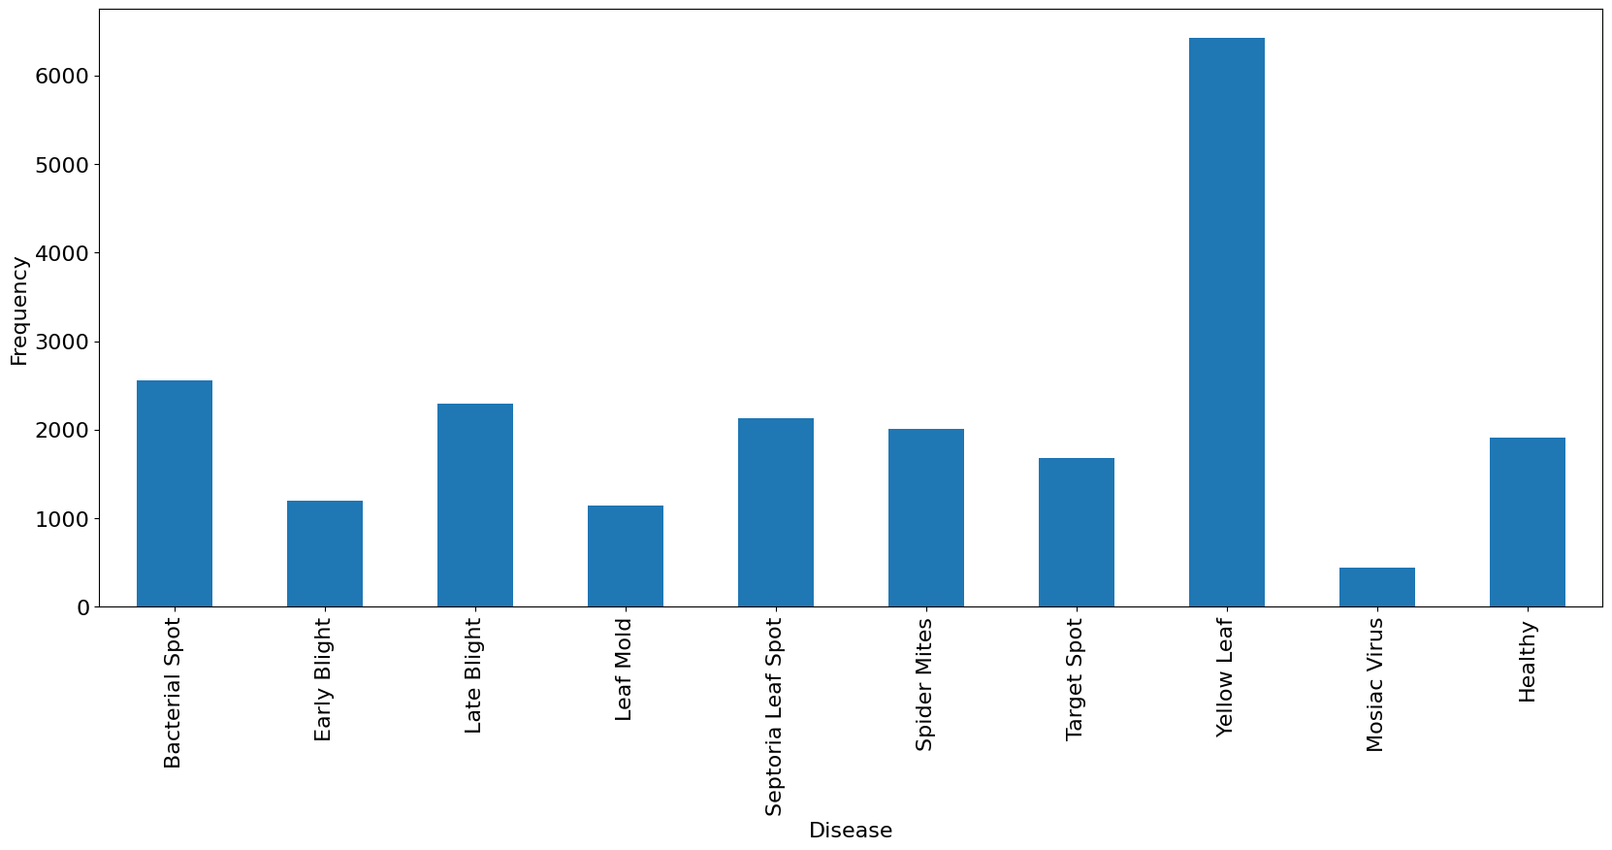
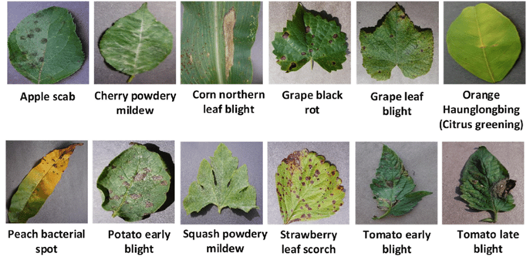
PlantVillage Dataset
Data collected from 30 countries
Total 54,303 images divided for 38 classes
18,160 tomato plant images for 10 classes
Distribution of different tomato classes in PlantVillage dataset
PlantVillage examples (Source: https://plantvillage.psu.edu/)

Slide 5
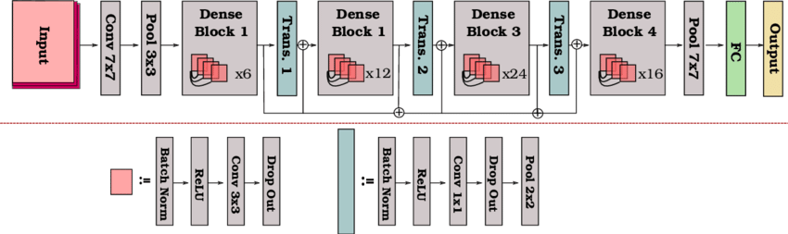
DenseNet121 model
DenseNet-121 consists of 4 Dense blocks containing different number of denselayers
Pre-trained on ImageNet
Architecture of DenseNet121 model
Source: A schematic illustration of the DenseNet-121 architecture [82]

Slide 6
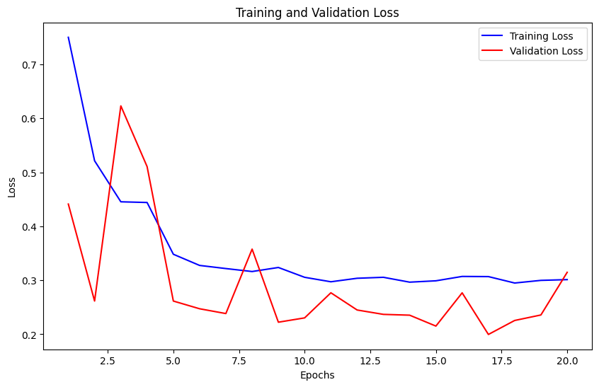
Training
Divided data into 80% train and 20% validation data
Fine-tuned model on tomato classes for 20 epochs
Achieved best validation accuracy of 92.5%

Slide 7
Visualizing Activations using GradCAM
Grad-CAM is a technique for visualizing and interpreting deep learning models
It generates heatmaps highlighting regions in an image that are most relevant to the prediction
Enhances model explainability by showing which image features contribute to a specific prediction

Slide 8
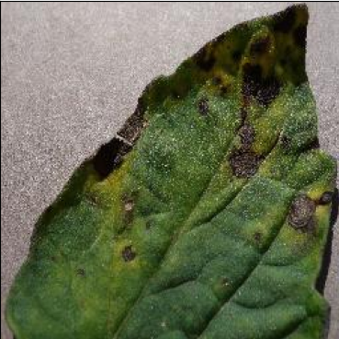
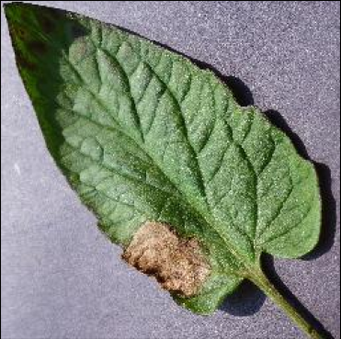
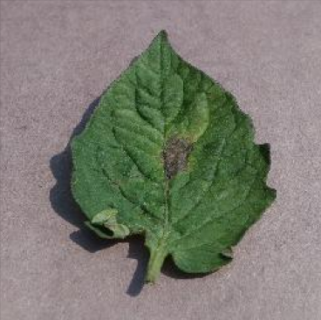
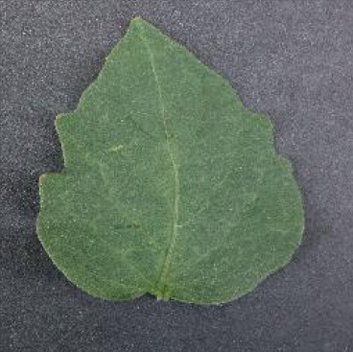
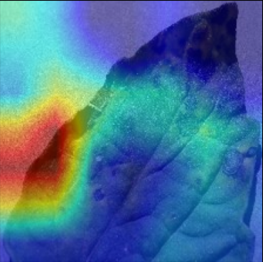
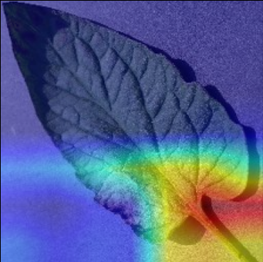
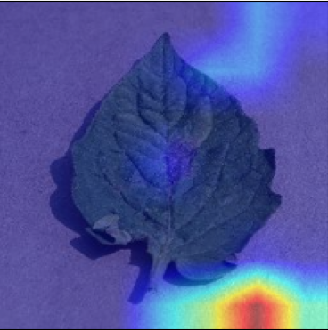
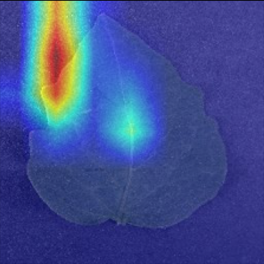
Samples of correctly classified images
GradCAM result

Slide 9
Observations
From the results in the previous slide we can observe
The model is not focusing on important parts of the leaf even for the correctly classified images
We get good accuracy values but still model does not have good interpretability
need to focus on improving the interpretability of the model to focus on important parts of images
For this we use transformers

Slide 10
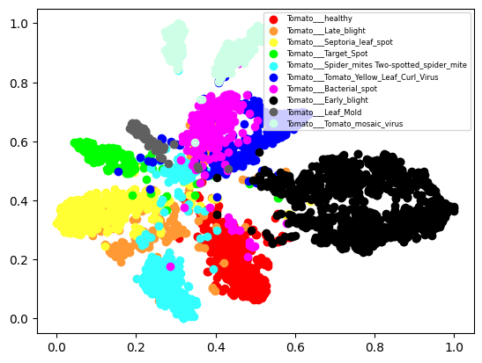
t-SNE analysis of DenseNet121 model
t-Distributed Stochastic Neighbor Embedding is a technique for dimensionality reduction for visualization of high dimension data
Used to explore patterns within the data
t-SNE plot of Final model

Slide 11
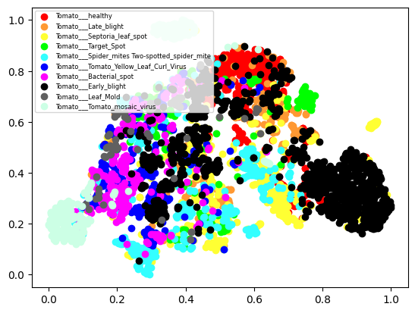
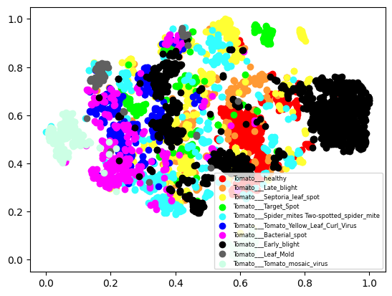
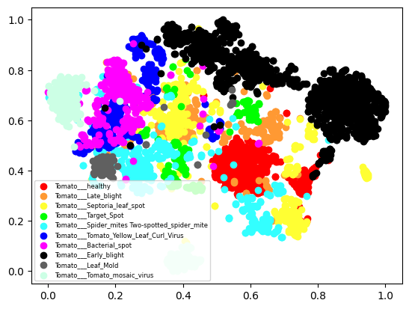
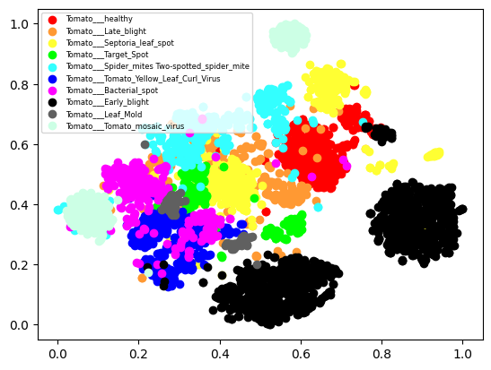
t-SNE plot for Denseblock1
t-SNE plot for Denseblock2
t-SNE plot for Denseblock3
t-SNE plot for Denseblock4

Slide 12
Observations
From the results in the previous slide we can observe
Clusters in t-SNE plots become more separated in the latter layers than earlier layers
This shows that latter layers are more important in deciding the final label of image than earlier layers as expected

Slide 13
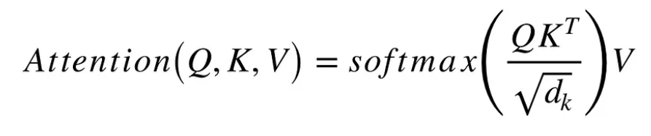
Attention
Usually used in NLP tasks for contextual information
Q - Query matrix: Vector representation of target word in the sequence
K - keys: Vector representation of all words in the sequence
V - Value matrix

Slide 14
Transformers
Self-attention + Neural Network
Encoder and Decoder architecture
Stores the spatial information along with the value of the pixel
Uses large amount of data
Vision Transformer (Google Research)
Data Efficient Image Transformers (Facebook Research)
Bidirectional Encoder Representations from Transformers (BERT)
GPT-3

Slide 15
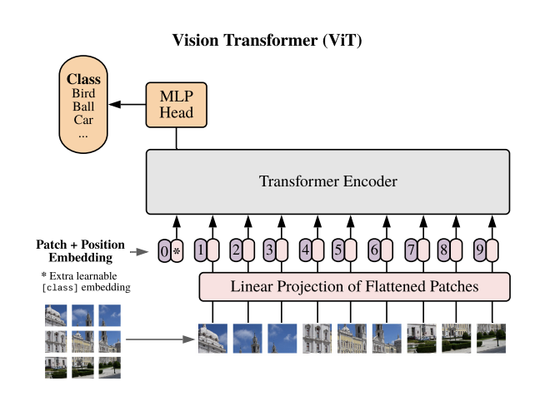
Vision Transformer (ViT)Dosovitskiy, A., Beyer, L., Kolesnikov, A., Weissenborn, D., Uszkoreit, J., Unterthiner, T., & Houlsby, N. (2021). An image is worth 16x16 words: Transformers for image recognition at scale. arXiv preprint arXiv:2010.11929
Pre-trained on ImageNet 21k
Uses self-attention
Uses positional encoding
Requires large amount of data for training
MLP Head - Two layer classification network
15+ variants based on patch size, architecture, pre-training dataset
Architecture of ViT model
(Source: The Vision Transformer Model-MachineLearningMastery.com)

Slide 16
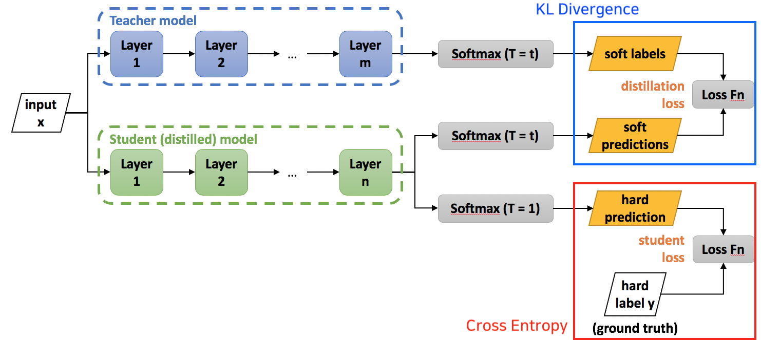
Data Efficient Image Transformers (DeiT) Touvron, H., Cord, M., Douze, M., Jegou, H., Joulin, A., & Lapoujade, M. (2021). Training data-efficient image transformers & distillation through attention. arXiv preprint arXiv:2012.12877
Pre-trained on ImageNet-1k
Provides better performance with less computation cost
Architecture based on ViT
Architecture of DeiT model
(Source : DeiT(Training Data efficient image transformers & distillation through attention))

Slide 17
Experiments
Both models were fine-tuned on PlantVillage dataset for tomato classes
Google colab gpu was used for training
Test accuracy achieved
95% with DeiT model
98.8% with ViT model

Slide 18
Comparison of three models
 | DenseNet121 | DeiT | ViT
Train acc | 89% (20 epochs) | 91% (20 epochs) | 98% (10 epochs)
Test acc | 92% | 95% | 98%
Time | 77 s/epoch | 60 s/epoch | 450 s/epoch
Size of model | 29 MB | 21.4 MB | 327.3 MB

Slide 19
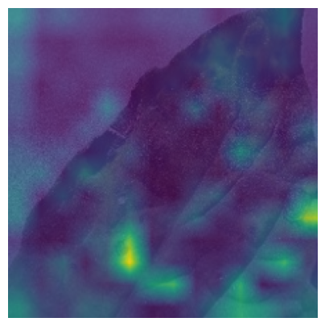
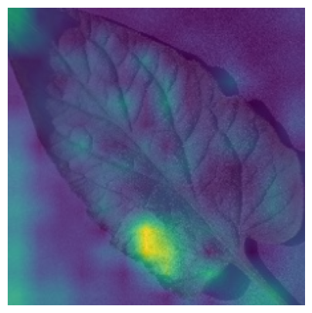
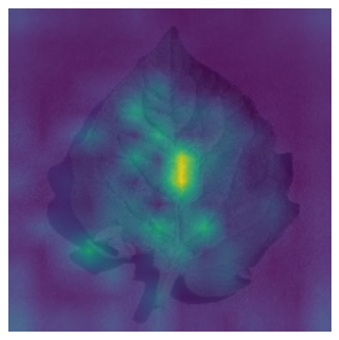
Original images
GradCAM result for DenseNet121
Attention map for DeiT

Slide 20
Observations
From the results in the previous slide we can observe
Transformers provide higher accuracy values than CNNs
Further transformer models are much more interpretable
These models focus on more important parts of the image due to attention mechanism

Slide 21
Automatic Leaf extraction from outdoor images
Nantheera Anantrasirichai, Sion Hannuna, and Nishan Canagarajah. "Automatic Leaf Extraction from Outdoor Images." arXiv preprint arXiv:1709.06437 (2017)
This paper proposes an leaf extraction technique through the following steps:
Non-greeen background removed by histogram thresholding
Local entropy used for removal of high texture/green background
Further refinement:
Using Hough transform to detect veins in leaf
Cubic interpolation

Slide 22
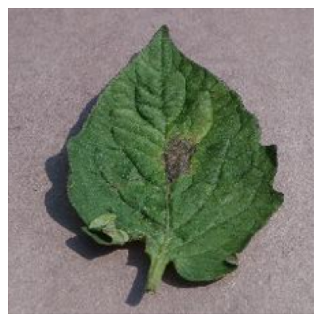
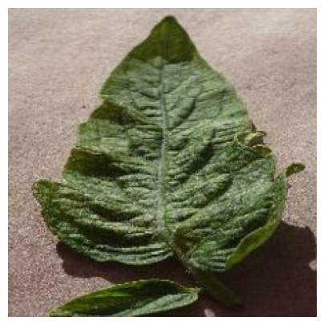
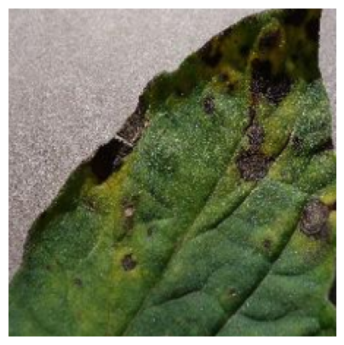
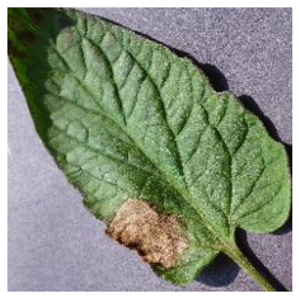
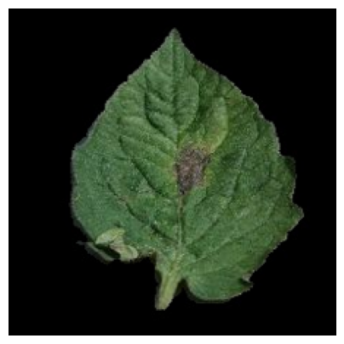
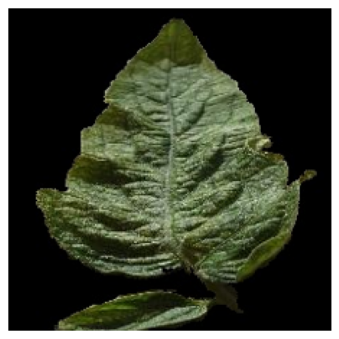
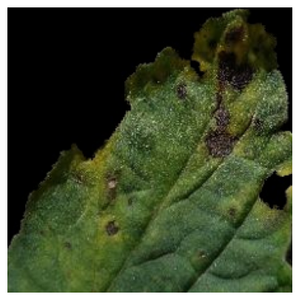
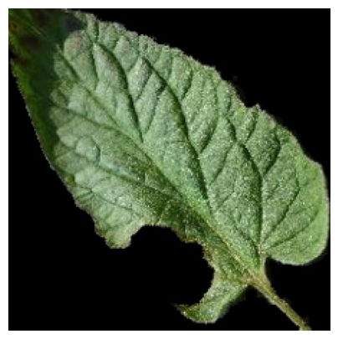
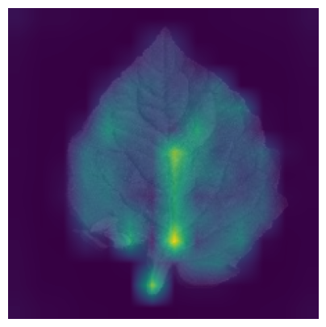
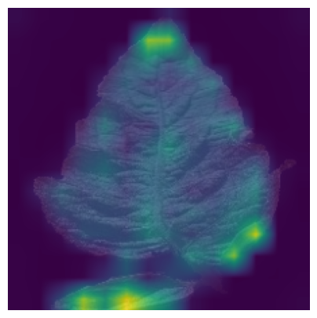
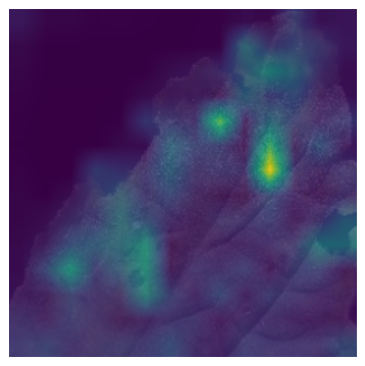
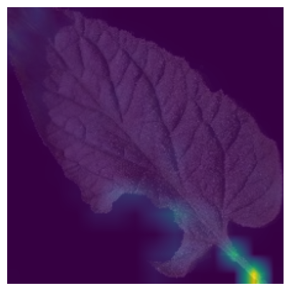
Original images
Background removed image
Attention map for DeiT

Slide 23
Observations
From the results in the previous slide we can observe
This background removal algorithm is not good because it can remove leaf part also sometimes due to green-coloured thresholding
This part that is removed from the leaf generally corresponds to diseased part
Although background removal helps in focusing more on the leaf only the background removal has to be very accurate

Slide 24
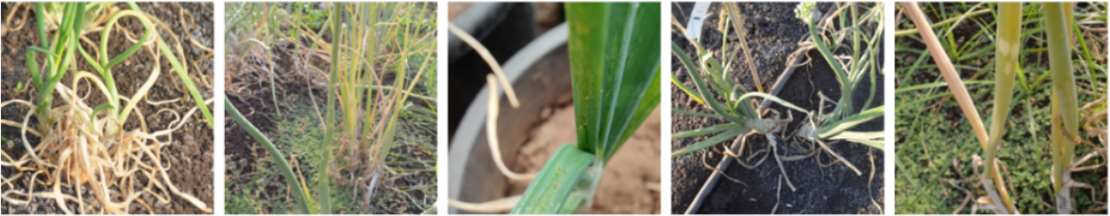
TiH Onion Data
Data collected at Directorate of Onion & Garlic Research (DOGR), Pune Onion dataset consisting of six classes:
Bulb rot: 717 images
Healthy Bulb: 17 images
Healthy seed: 99 images
IYSV: 754 images
Thrips Insect: 240 images
Thrips Symptoms: 306 images
Sample images from TiH Onion data

Slide 25
Training
DeiT model used
Bulb rot, IYSV, Thrips combined classes used only
Epochs: 10
Data split:
50% train data
25% validation data
25% test data
Pre-trained on ImageNet

Slide 26
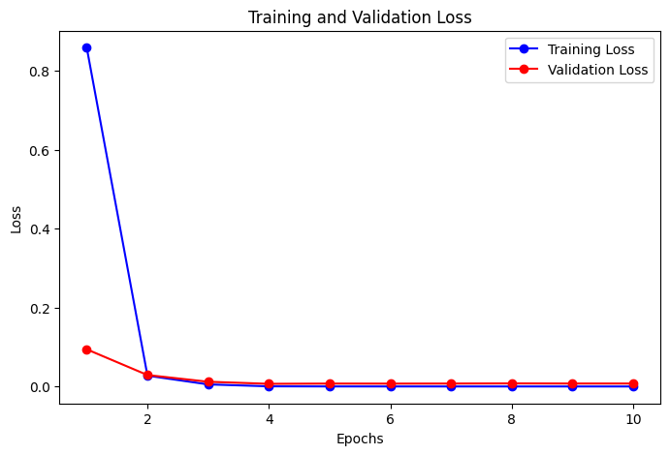
Results
Best training accuracy: 100%
Validation accuracy: 99.6%
Test accuracy: 99.8%
Training time: 50.8 s/epoch

Slide 27
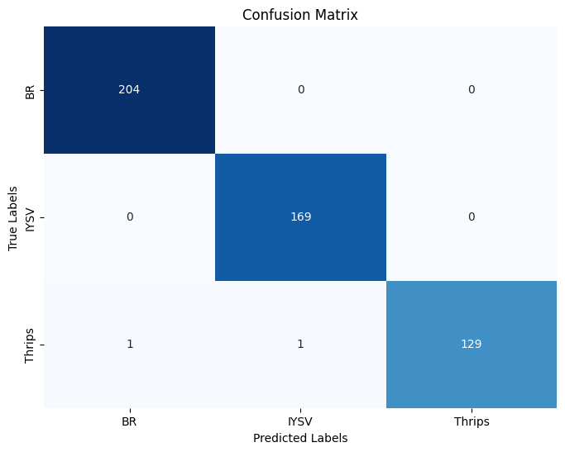
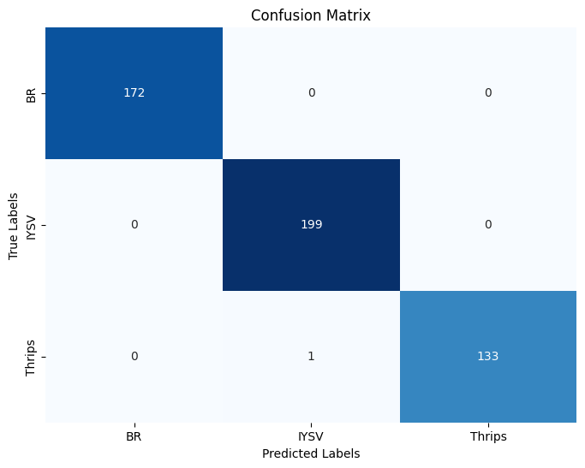
Confusion matrix
For validation data
For testing data

Slide 28
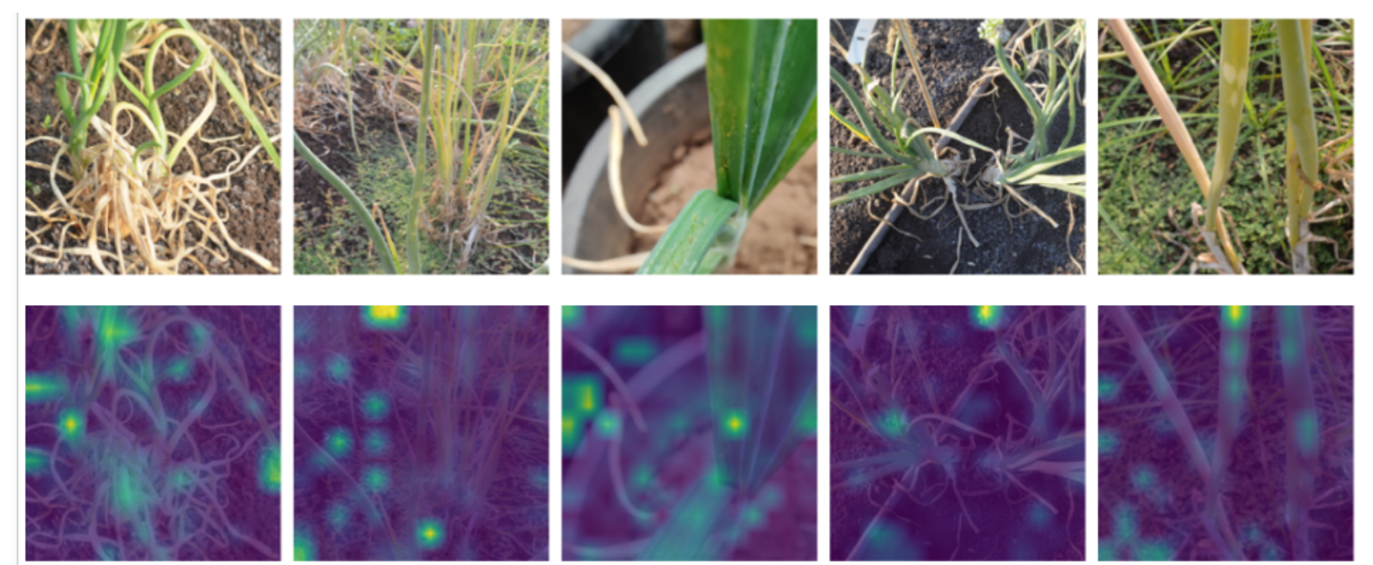
Original Images
Attention maps

Slide 29
Observations
From the results of DeiT model on Onion dataset we can conclude
DeiT model is overfitting on the data based on loss graph and confusion matrices
This is due to very less number of images for transformers and many images are very similar to each other
To address this issue we will have to look at techniques to increase our data, and train DeiT model using less data

Slide 30
Conclusion
Transformers provide 3-5% improvement in accuracy relative to CNNs
Transformers models are also much more interpretable and explainable in terms of activations map and focusing on important parts of image
Using Transformers for onion dataset, overfitted on this dataset due to small number of images and similar looking images
Two main challenges needed to address to improve on the Onion dataset:
Training transformer model using less data
Background removal

Slide 31
THANK YOU!

Slide 32
Appendix

Slide 33
Literature Survey
Transformers:
Training data-efficient image transformers and distillation through attention
An Image is Worth 16x16 Words: Transformers for Image Recognition at Scale
Grad-CAM: Visual Explanations from Deep Networks via Gradient-based Localization
Mechanism of Feature Learning in Deep Fully Connected Networks and Kernel Machines that Recursively Learn Features
Automatic Leaf Extraction From Outdoor Images

Slide 34
References
Selvaraju, R. R., Cogswell, M., Das, A., Vedantam, R., Parikh, D., & Batra, D. (2017). Grad-CAM: Visual Explanations from Deep Networks via Gradient-based Localization. In Proceedings of the IEEE International Conference on Computer Vision (ICCV) (pp. 618-626)
Dosovitskiy, A., Beyer, L., Kolesnikov, A., Weissenborn, D., Uszkoreit, J., Unterthiner, T., & Houlsby, N. (2021). An image is worth 16x16 words: Transformers for image recognition at scale. arXiv preprint arXiv:2010.11929
Radhakrishnan, A., Beaglehole, D., Pandit, P., & Belkin, M. (2022). Mechanism of feature learning in deep fully connected networks and kernel machines that recursively learn features. arXiv preprint arXiv:2212.13881
Touvron, H., Cord, M., Douze, M., Jegou, H., Joulin, A., & Lapoujade, M. (2021). Training data-efficient image transformers & distillation through attention. arXiv preprint arXiv:2012.12877
Nantheera Anantrasirichai, Sion Hannuna, and Nishan Canagarajah. "Automatic Leaf Extraction from Outdoor Images." arXiv preprint arXiv:1709.06437 (2017)

